Slide 1

Systems Ne2ition
Like Google to your network
M. Frazier Davidson
VP Sales, Eastern US Frazier.Davidson@wirex-systems.com m. 614-286-9878
Philip Campeau
Global Systems Engineering Manager Philip.Campeau@wirex-systems.com
m. 312-622-3160

Slide 2
The Visibility Gap
What’s Missing in Investigations, Hunts, and Claims
Notes:
Speaker Notes:
Most environments use a patchwork of tools. They log events, monitor endpoints, or collect flows, but they rarely tell us what actually happened. And long-term data storage costs often lead to gaps at the worst times.

Slide 3
Flow
Visibility needed
Commonality
How to get it today
Where visibility falls short
Bridging the gaps
Outcomes & Impact

Slide 4
The Visibility Gap
1.
Disconnected tools across endpoint, network, and cloud
2.
Context is critical
3.
Storage cost constraints limit data retention

Slide 5

Visibility critical during an
Incident Investigation
Initial Access Point Where and how did attacker enter?
Command & Control (C2) Was the attacker communicating externally?
Lateral Movement What internal systems were accessed post-compromise?
Session Reconstruction What actions did the attacker take, step by step?
Data Access & Exfiltration
What sensitive data was viewed, queried, or stolen?
TTPs Used
Which MITRE ATT&CK techniques were involved?
Notes:
Speaker Notes: While each function has its own goals, the types of visibility needed have surprising overlaps.

Slide 6
Visibility critical during an
Cyber Insurance Claim
FOR THE BUSINESS (filing the claim)
Scope and Impact What data & systems were compromised?
Timely Identification When did actions occur, and how quickly were they identified?
Evidence of Security Controls Can you prove best practices were in place?
Regulatory Implications Was regulated data (PII, PHI, PCI) affected?
Notes:
Speaker Notes: While each function has its own goals, the types of visibility needed have surprising overlaps.

Slide 7
Visibility critical during an
Cyber Insurance Claim
FOR THE INSURER
Verification of Loss What evidence confirms actual harm or liability?
Documentation & Timelines Can the event be traced with high-fidelity logs or reconstructions?
Causality
Was it a result of poor hygiene, a zero day, or third party?
Forensic Confidence Is the data complete, validated, and defensible?
Notes:
Speaker Notes: While each function has its own goals, the types of visibility needed have surprising overlaps.

Slide 8
Visibility critical during an
Threat Hunts
Behavior Anomalies Lateral movement, protocol misuse, privilege escalation
Context-Rich Telemetry Beyond logs/metadata…what was actually happening at the application and data layer?
Unusual Data Access Out of pattern queries or downloads
Historical Depth Ability to go back weeks/months to find dormant IOCs or slow-moving threats
East/West Traffic Visibility What internal Movements often evade perimeter tools
Notes:
Speaker Notes: While each function has its own goals, the types of visibility needed have surprising overlaps.

Slide 9
The Overlap: Critical Visibility
Common Need | Why It Matters
Full Session Visibility | Reconstructing attacker behavior, user actions, and data flows.
Payload-Level Context | Metadata: “user X accessed db Y at 10:42am from IP Z” Payload: “User X ran this SQL query: SELECT * FROM customer_ssn WHERE income > 100000, and 500 sensitive records were returned”, files, emails
Lateral Movement Detection | Key to understanding scope and hunting hidden threats.
Data Exposure Insights | Needed to assess breach impact or reporting requirements.
Time-Aligned Telemetry | High-resolution, correlated across users, apps, and systems.
Long-Term Retention | Necessary for delayed threats, validation of historical data access, and supporting investigations or claims that emerge months after the initial incident.
Notes:
Speaker Notes: At the core of all three use cases is this central question: What data was actually accessed, and how? Without that, you're left guessing in every scenario.
What sensitive data was viewed, queried, or stolen
Evidence of actual harm
What was actually happening

Slide 10
Tools Commonly Used
Scenario | Common Tools Used
Incident Investigation | SIEM (Splunk, NG-SIEM) + Threat Intel EDR (CrowdStrike, SentinelOne) NDR/Metadata (Zeek, Corelight, ExtraHop, NetFlow) PCAP (NetWitness) Cloud-native logs (VPC Flow Logs, CloudTrail, Azure NSG Flow)
Cyber Insurance Claims | SIEM Logs and Audit Trails EDR Evidence DLP Logs Cloud audit logs Reports from IR firms using cloud-native or third-party tools
Threat Hunting | SIEM (Splunk, NG-SIEM) + Threat Intel EDR (CrowdStrike, SentinelOne) NDR/Metadata (Zeek, Corelight, ExtraHop, NetFlow) Cloud activity monitoring (AWS GuardDuty, GCP SCC, Azure Defender) Manual query-based threat hunts (e.g. Athena, BigQuery)
Notes:
Speaker Notes: At the core of all three use cases is this central question: What data was actually accessed, and how? Without that, you're left guessing in every scenario.

Slide 11
Common Gaps Across Tools
Gap | Why It Matters
Fragmented Visibility | Data is siloed across network, endpoint, cloud, and SaaS tools. EDRs don’t always see exfiltration or lateral movement outside the endpoint. Pivot fatigue + incomplete pictures
Metadata-Only Visibility | Cloud flow logs, metadata, NetFlow and audit trails lack payload. Can’t prove what data was seen, returned, or touched—only that a query occurred.
Limited Historical Retention | Logs are often sampled or aged out quickly to manage cost. When NDR logs (e.g. Zeek) are exported to a SIEM, they often make up ~60% of log volume, dramatically inflating storage costs. May also not have data when it is needed later.
Slow Forensic Timelines | Correlating activity across attack surfaces requires time-consuming and skilled analysis and session reconstruction
Notes:
Speaker Notes: At the core of all three use cases is this central question: What data was actually accessed, and how? Without that, you're left guessing in every scenario.

Slide 12
Bridging the Gap
WireX Systems Capability | Value Delivered Across Use Cases
Full Payload Capture | Enables true session replay and proof of what data was accessed for up to 9 months Sees inside protocols and applications & full data interactions, not just flows or logs Parses 100+ protocols; understands user behavior, file access, SQL queries, etc.
Long-term retention | Supports delayed breach discovery, extended investigations, insurance claim timelines, historical data access compliance reporting, etc.
Integrated Investigator Workspace & Automated Session Reconstruction | Consolidates evidence from across attack surfaces—no need to pivot tools or manually stitch logs. Combines investigation, response, and evidence packaging Empowers & up-skills analysts - analysts review answers, not raw data
Fast, Defensible Forensics | Generates artifacts for legal, compliance, and insurance claims. Detects and categorizes access to sensitive data (PII, PHI, PCI, etc.) Deliver proof & scope of data exposure (or non-exposure)
Notes:
Speaker Notes: WireX was built to solve this problem. It collects full-session context, retains it affordably, and makes it accessible instantly for responders, auditors, and hunters.
Full payload capture with deep application awareness
Unified-format visibility across cloud, network, and virtual
Integrated investigation workspace
Long-term retention (9+ months)
Automated detection of sensitive data access

Slide 13

Real-World Outcomes
Instant Clarity
Accelerated Incident Response
Comprehensive Threat Detection
Empowered Analysts
Notes:
Speaker Notes: The result is faster answers, lower costs, and better outcomes across every security function that depends on data visibility.

Slide 14
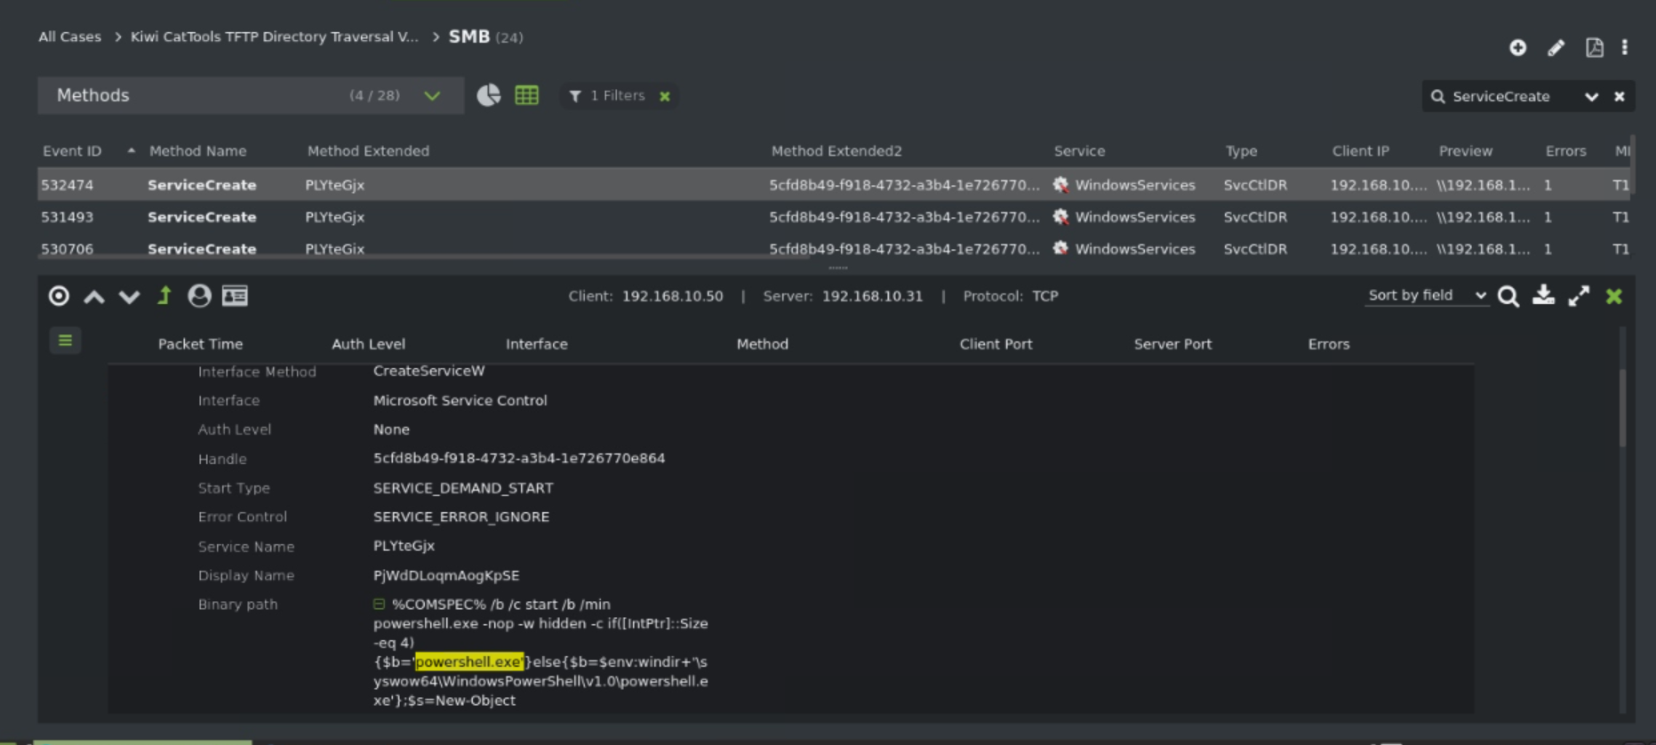

Slide 15
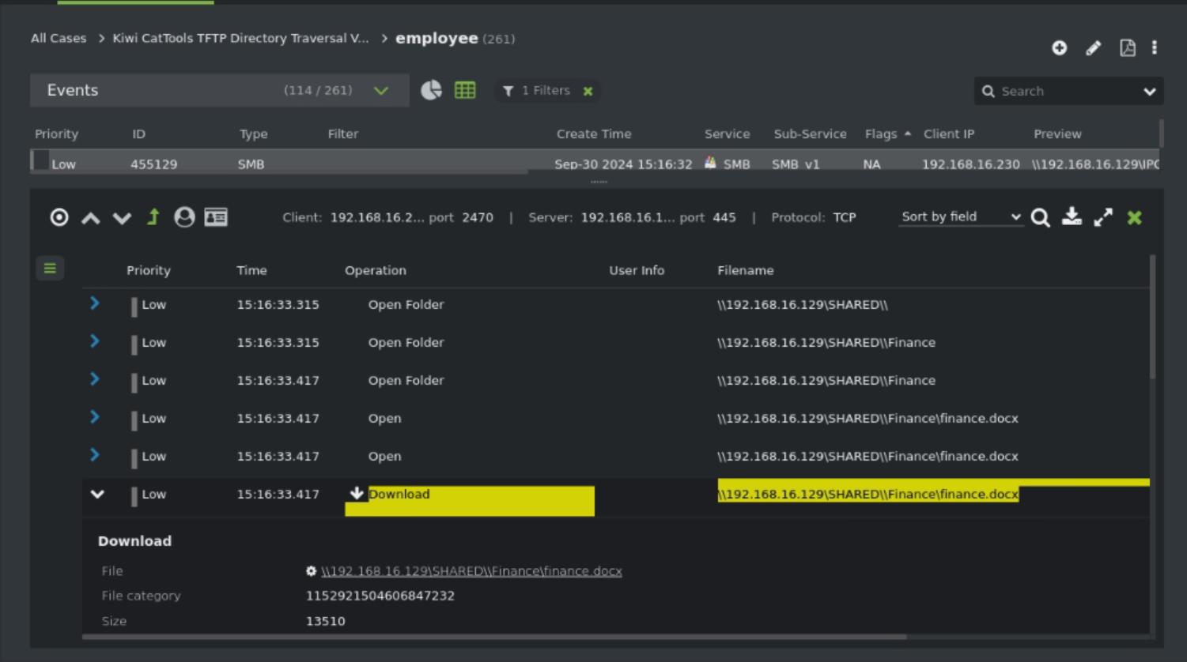

Slide 16
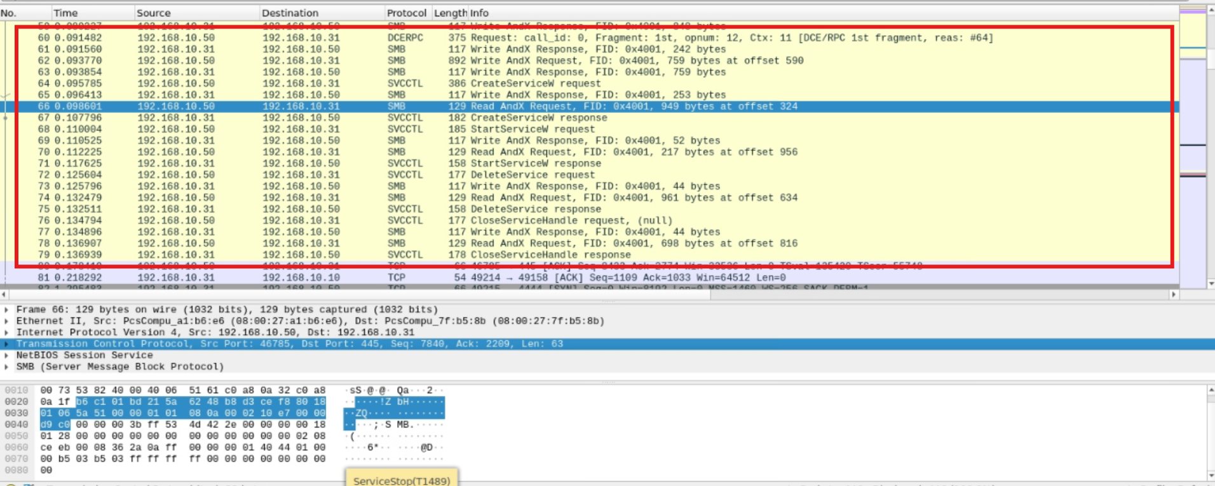

Slide 17
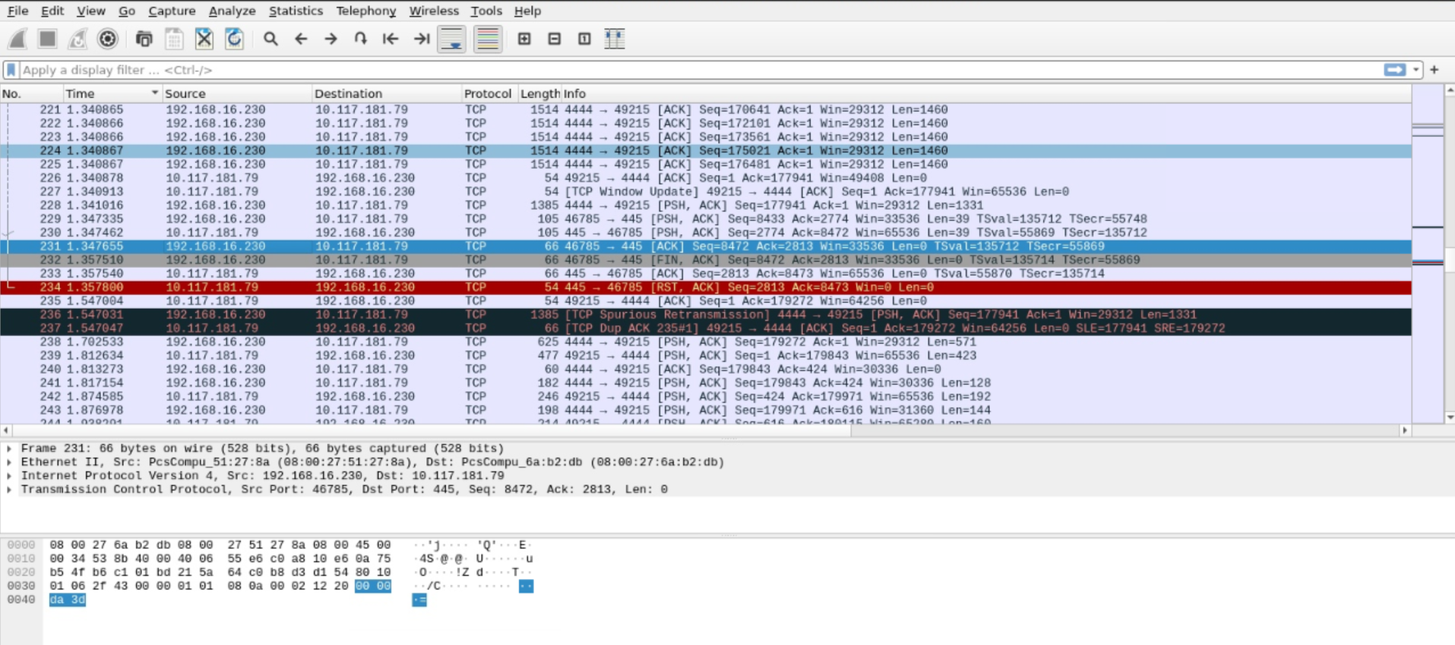

Slide 18
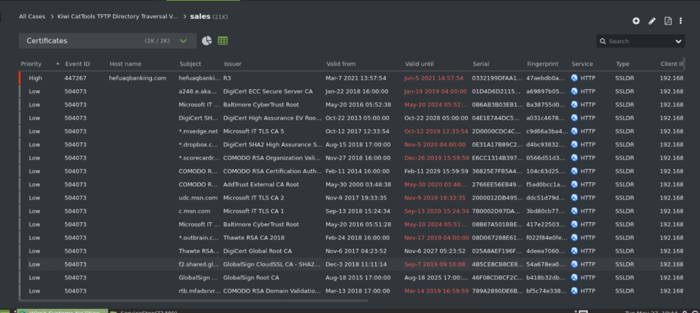

Slide 19
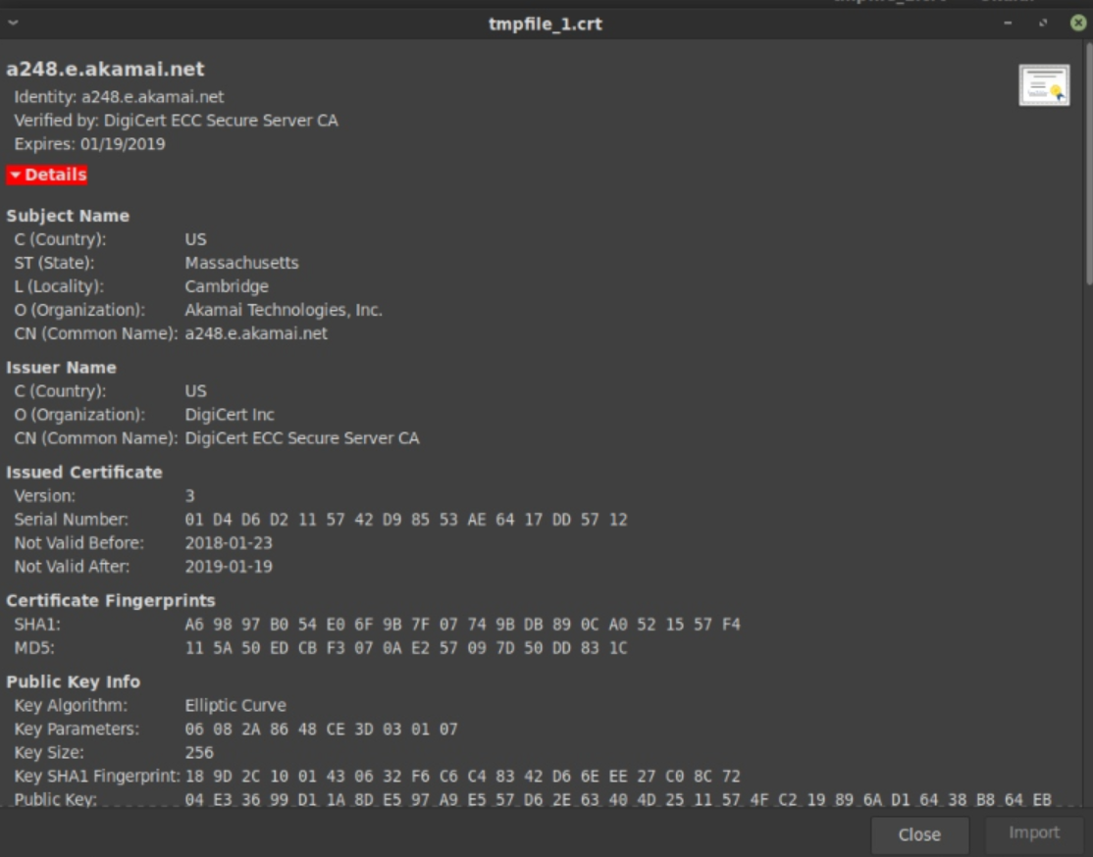

Slide 20
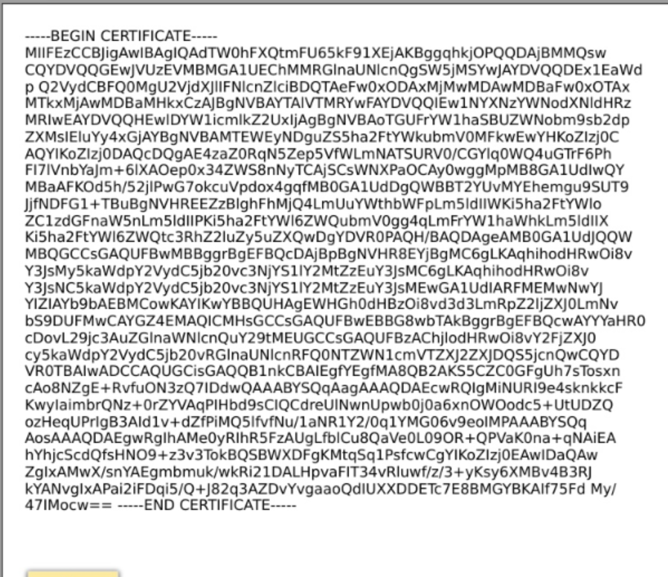

Slide 21
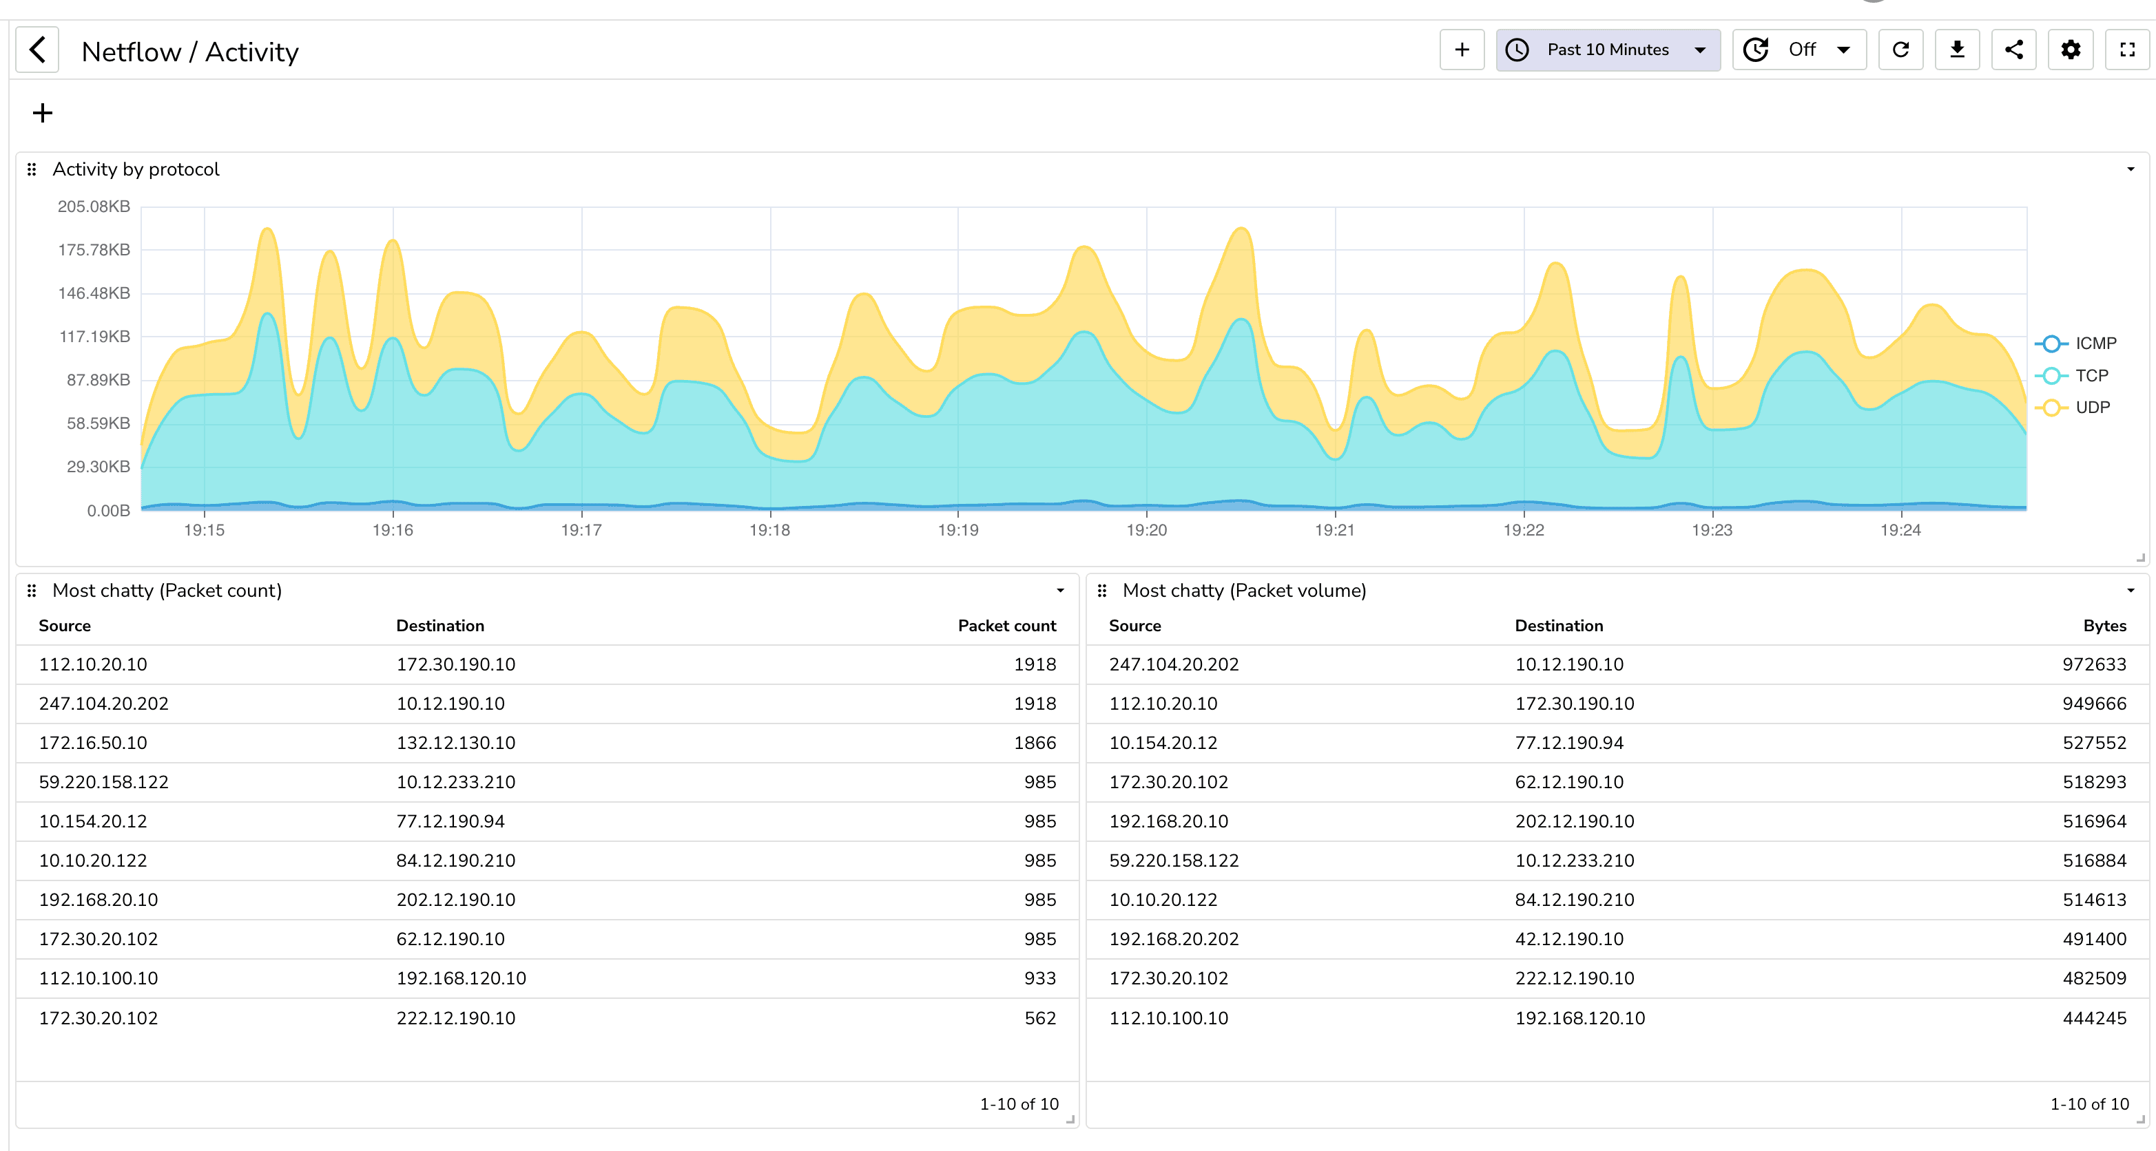

Slide 22
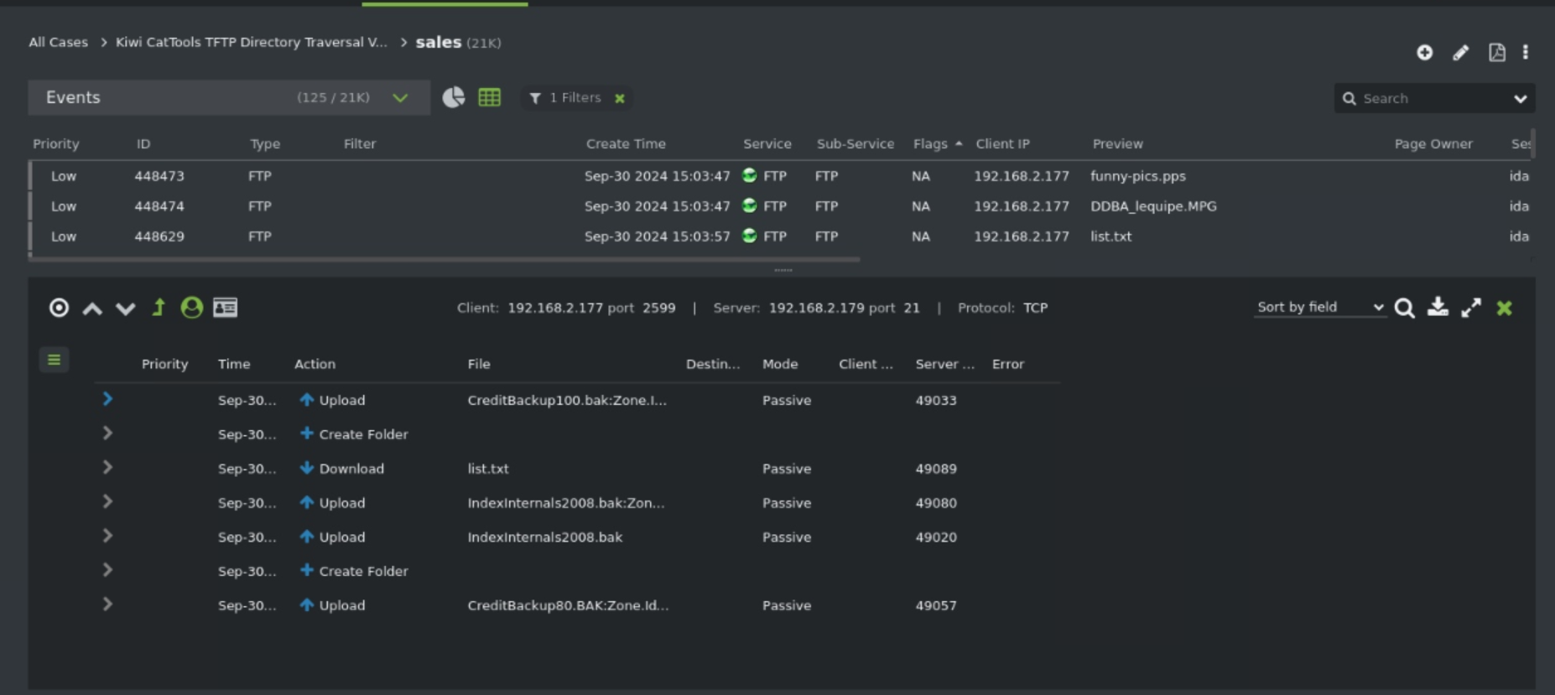

Slide 23
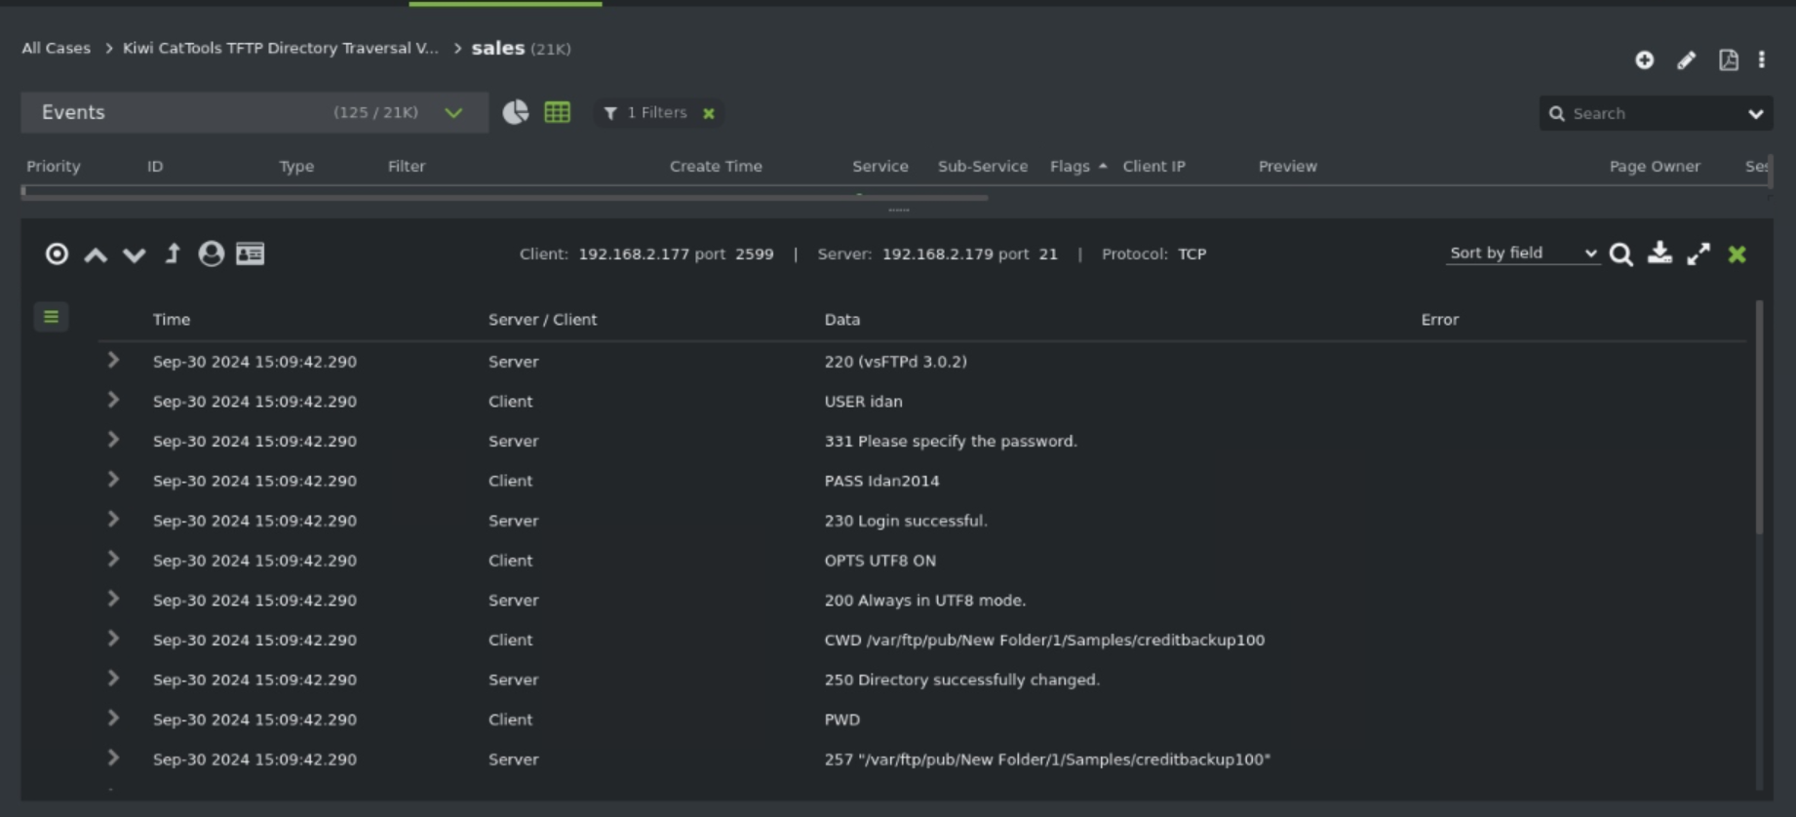

Slide 24
Systems Ne2ition
Thank you!
M. Frazier Davidson
VP Sales, Eastern US Frazier.Davidson@wirex-systems.com m. 614-286-9878
Philip Campeau
Global Systems Engineering Manager Philip.Campeau@wirex-systems.com
m. 312-622-3160

